Slide 1





Accreditation Erasmus +, 2024-1-RO01-KA121-SCH-000216478
___________________________________________________________________________________________________________
Mobility in Skopje, the Republic of North Macedonia 3th – 6th December 2024

Slide 2
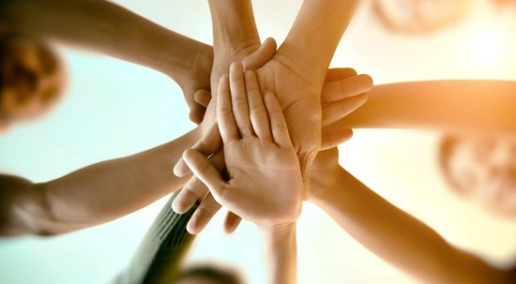
ROMANIAN TEAM
BY: Moldovanu Cosmin, Laurentiu Maticiuc, Maria Gaina, Bianca Gheorghian, Solonca Gabriela, Trofin Alexandra, Stoica Gesica, Turca Rebeca.

Slide 3
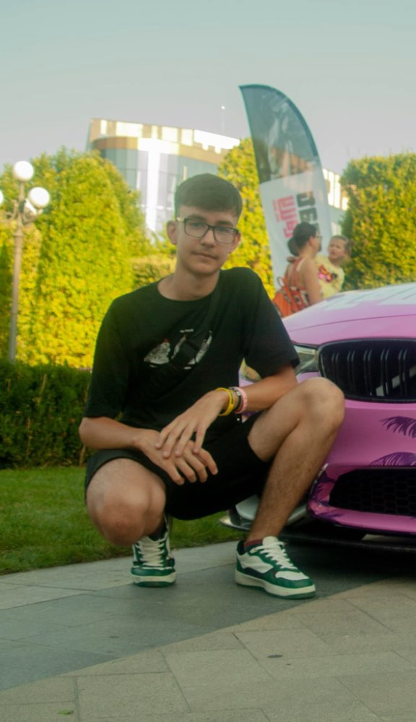
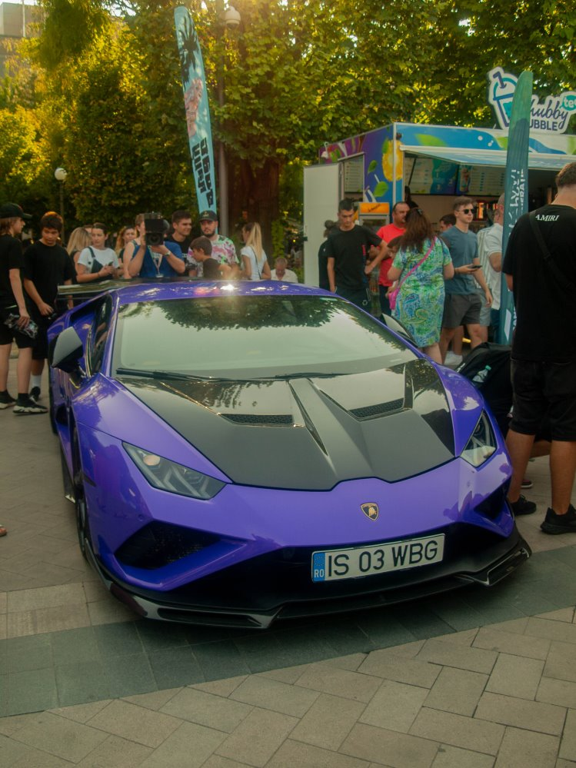
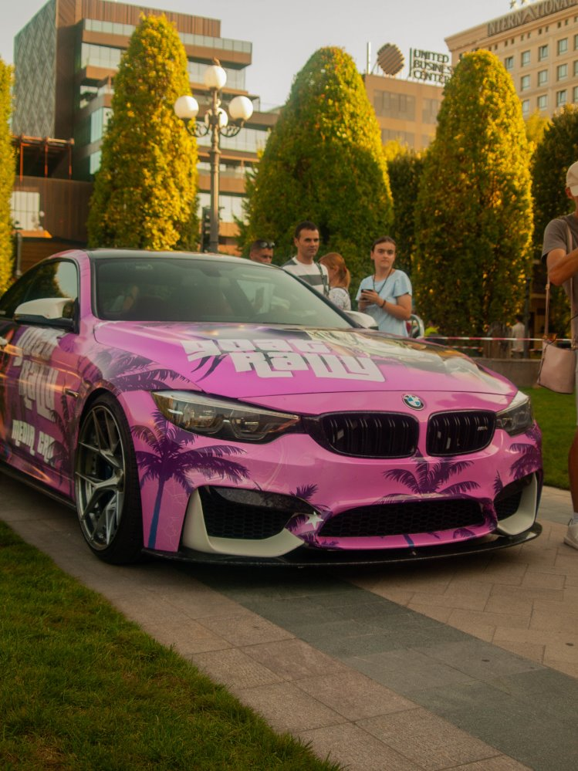
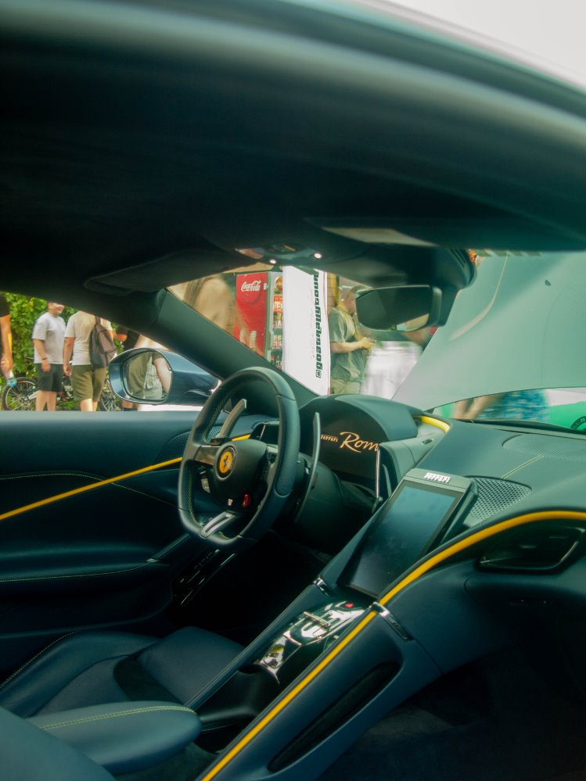
Moldovanu Cosmin
Hi! My name is Moldovanu Cosmin, I'm 13 years old and I'm from Romania! I am currently studying at Petru Rares Secondary School from Harlau and I'm in 7th grade. My favorite hobbies are photography, playing games, and riding my bike.

Slide 4
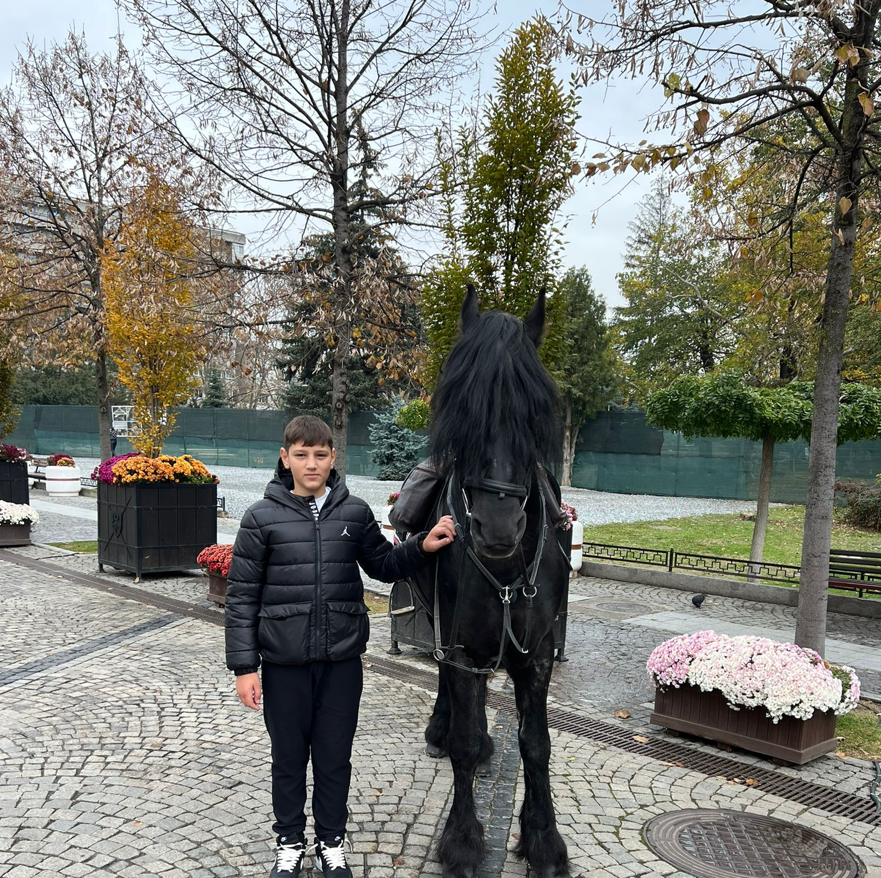
MATICIUC LAURENTIU
Hi! My name is Maticiuc Laurentiu, I'm thirteen years old and my hobbies are: Kick Boxing, Football and I'm also passionate about Atvs?. Kick boxing is my favorite hobby because I have won many matches and I have travelled around almost all of Romania, I also really like animals especially pigeons.

Slide 5
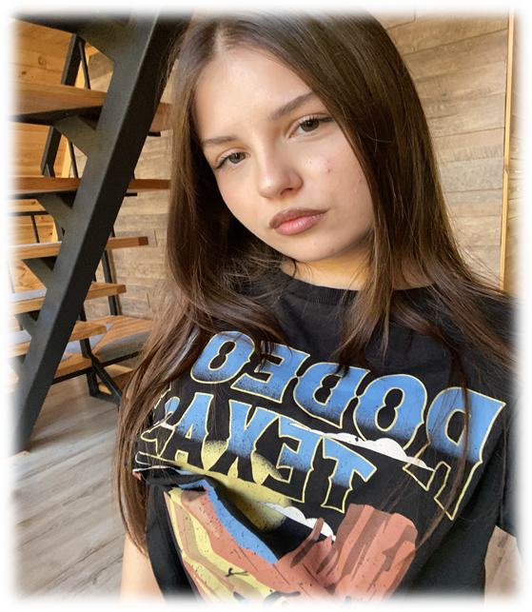
Maria Gaina
Hello,my name is Maria I am 14 years old ,I live in Romania in the city of Iasi and my hobbies are art and sports like volley-ball
I'm a kind person and I love to interact with new people and make new friends

Slide 6
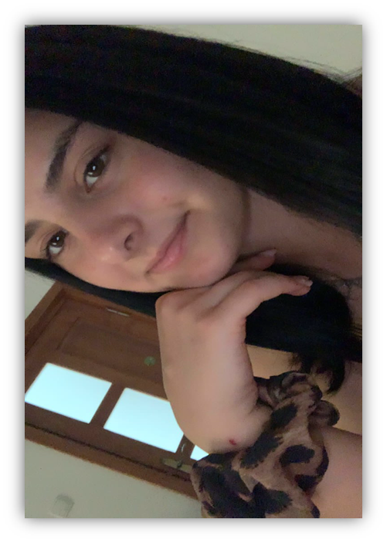
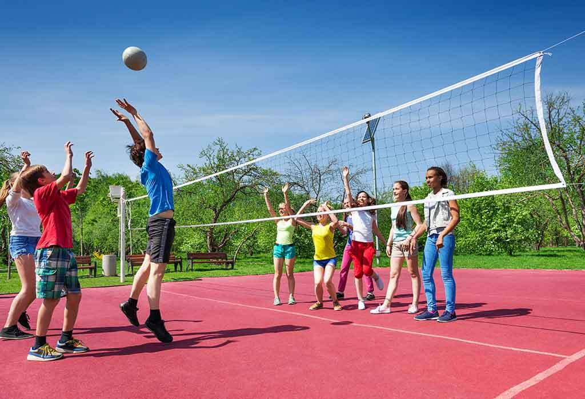
Bianca Gheorghian
Hello, I'm Bianca, I am 14 years old and I love video games and playing volley-ball.

Slide 7
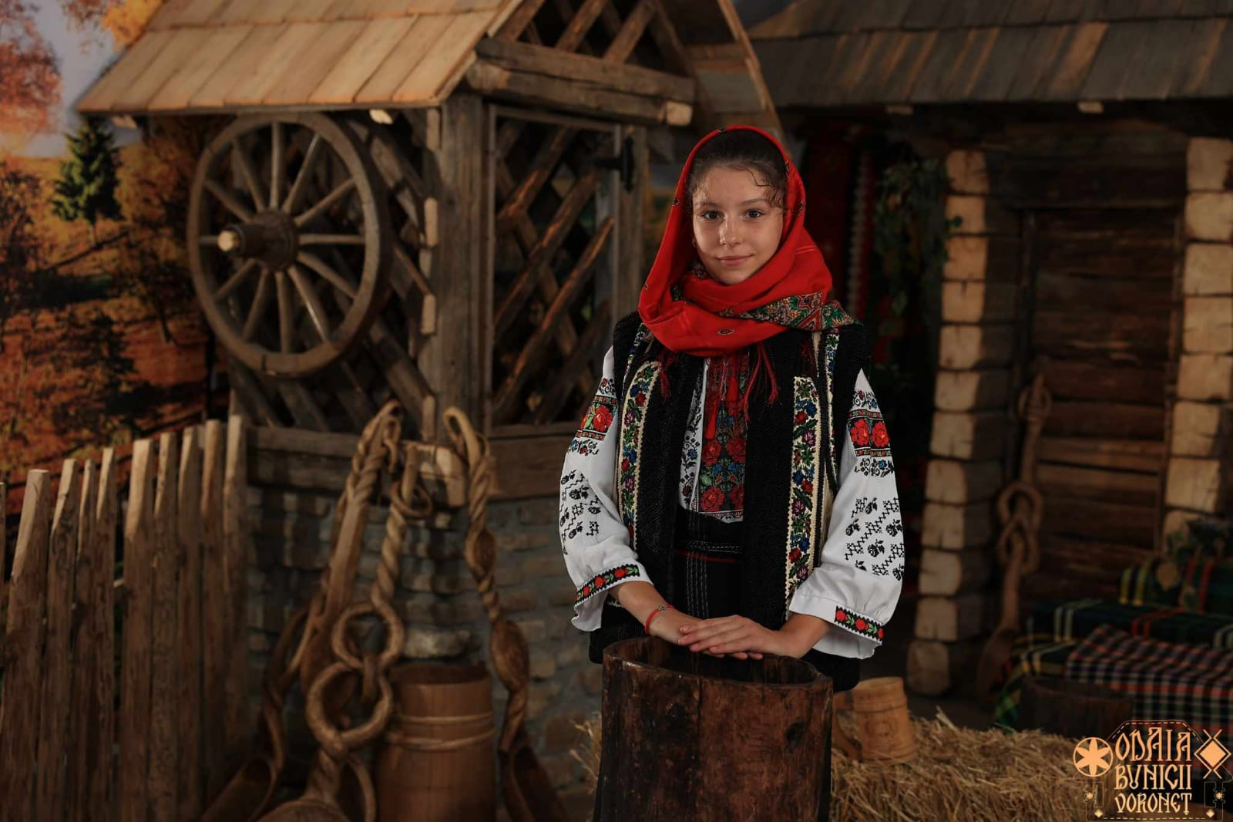
Solonca Gabriela
Hello! My name is Gabriela, I am 14 years old. I am in the 7th grade at the "Petru Rares Secondary School" in Harlau. I was born in Romania and I belong to the city of Harlau. I have a sister and two older brothers and one cat. I like to draw and spend time with my friends

Slide 8
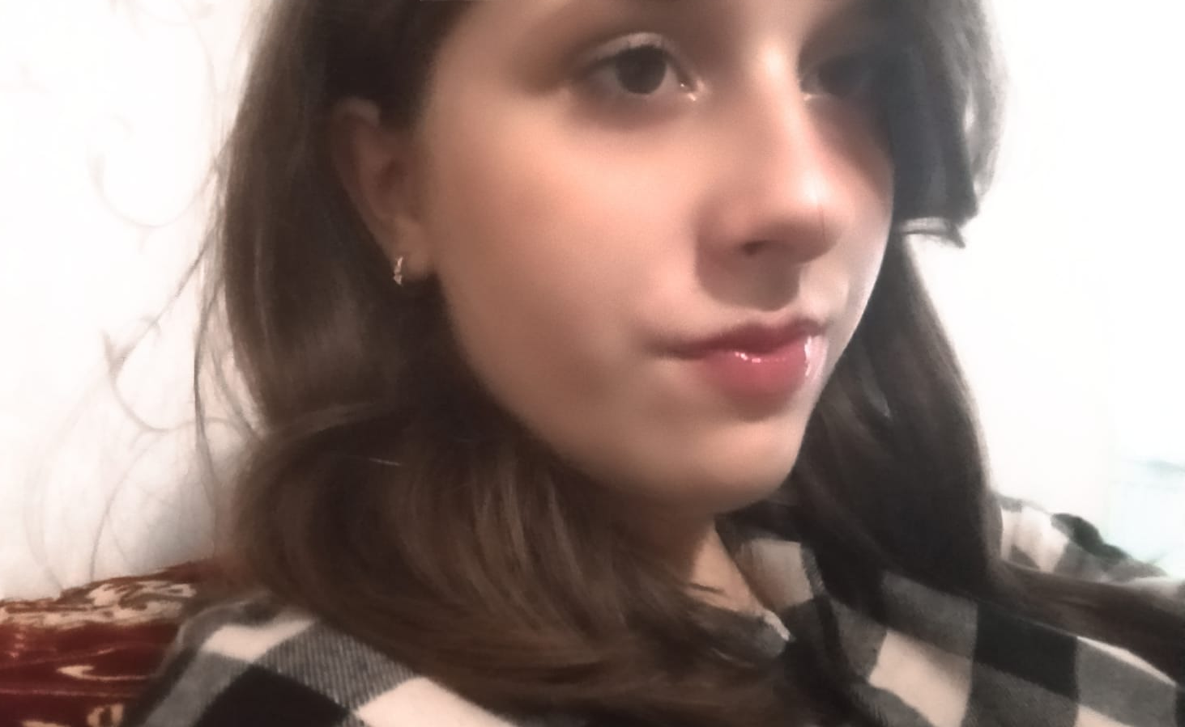
Trofin Alexandra
Hello everyone!
My name is Alexandra, but my friends call me Ale. I am 14 years old and my hobbies are singing, studying phisics and learning new languages.

Slide 9
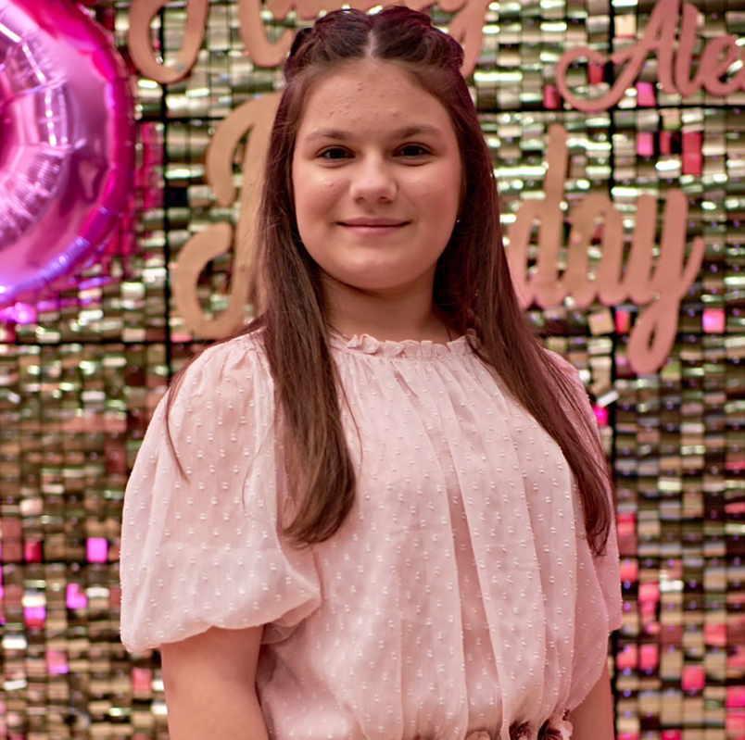
Stoica Gesica
Hello! My name is Stoica Gesica, I am 13 years old and I like to ride the ATV and to play handball.

Slide 10
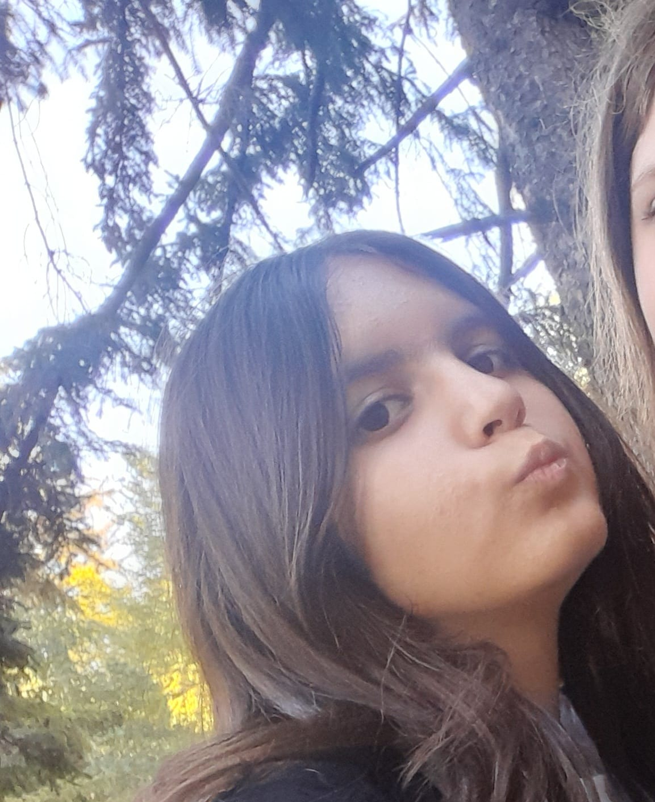

Turcă Rebecca
Hello! My name is Turcă Rebecca, but my friends call me Nini. I am 14 years old and my hobbies are singing, dancing, drawing and watching anime.

Slide 11
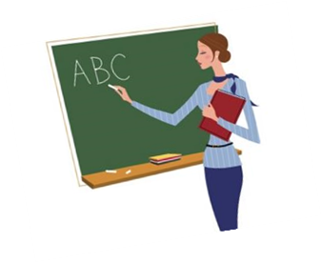
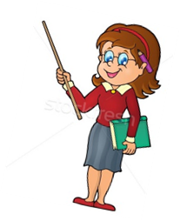
Teachers
__________________________________________________________________________________________________
Mrs Mirela Tican
Mrs CRISTINA URSACHE
Religion education teacher
primary school teacher

